Slide 1
Flight Risk-y Business
Senior Design 1

Slide 2
Team Members
Karam Anadani (CS) -- Team Lead, Enterprise Architecture
Andrew Fischer (CS) -- Front End Engineering
Adam Carrell (CS) -- Back End Engineering

Slide 3
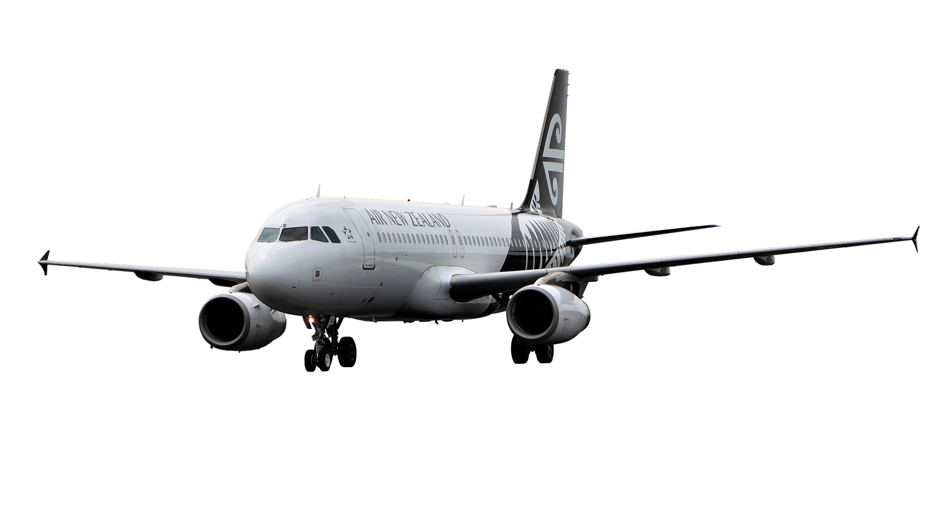
Who’s affected?
Passengers
Bad Experience
Time is Money
Airports
Congestions & Gate Availability
Airlines
30% of all us flights gets delayed
Up-to 12% get cancelled
Adam
Notes:
Arrive hours early without need.
Waste precious hour(s) of your life needlessly
Covid-19 loves that extra time you spend around strangers at airports
Millions of dollars lost in operational costs due to aircrafts sitting on the ground
Congested airports due to gate availability
Average of 30% of all US domestic flights are delayed, up-to 12% of airlines annual schedules gets eventually cancelled
Most Delay calculation happens with in a class, we are trying to personalize and make make it individualistic

Slide 4

How will our application solve this?
Past Flight Records
Current Airline Schedules
Dynamic Weather Data
Machine Learning
Andrew
Notes:
By using past flight records of arrivals/departures and corresponding delays, and also incorporating weather events, we will utilize machine learning to predict when a particular flight is likely to be delayed, and for how long.

Slide 5
Progress
Initial Infrastructure Done
User Interface
Inputting data
Returning percent chance
Next Semester:
Machine Learning
Weather Tracker
Web Hook
Beautify User Interface

